Slide 1


Javascript all the platforms!
Damian Karzon
@dkarzon
Marker Metro

Slide 2
What are we doing?
What is Cordova?
Tools (Command line and Visual Studio)
Building and deploy for multiple platforms
Frameworks/libraries to help

Slide 3
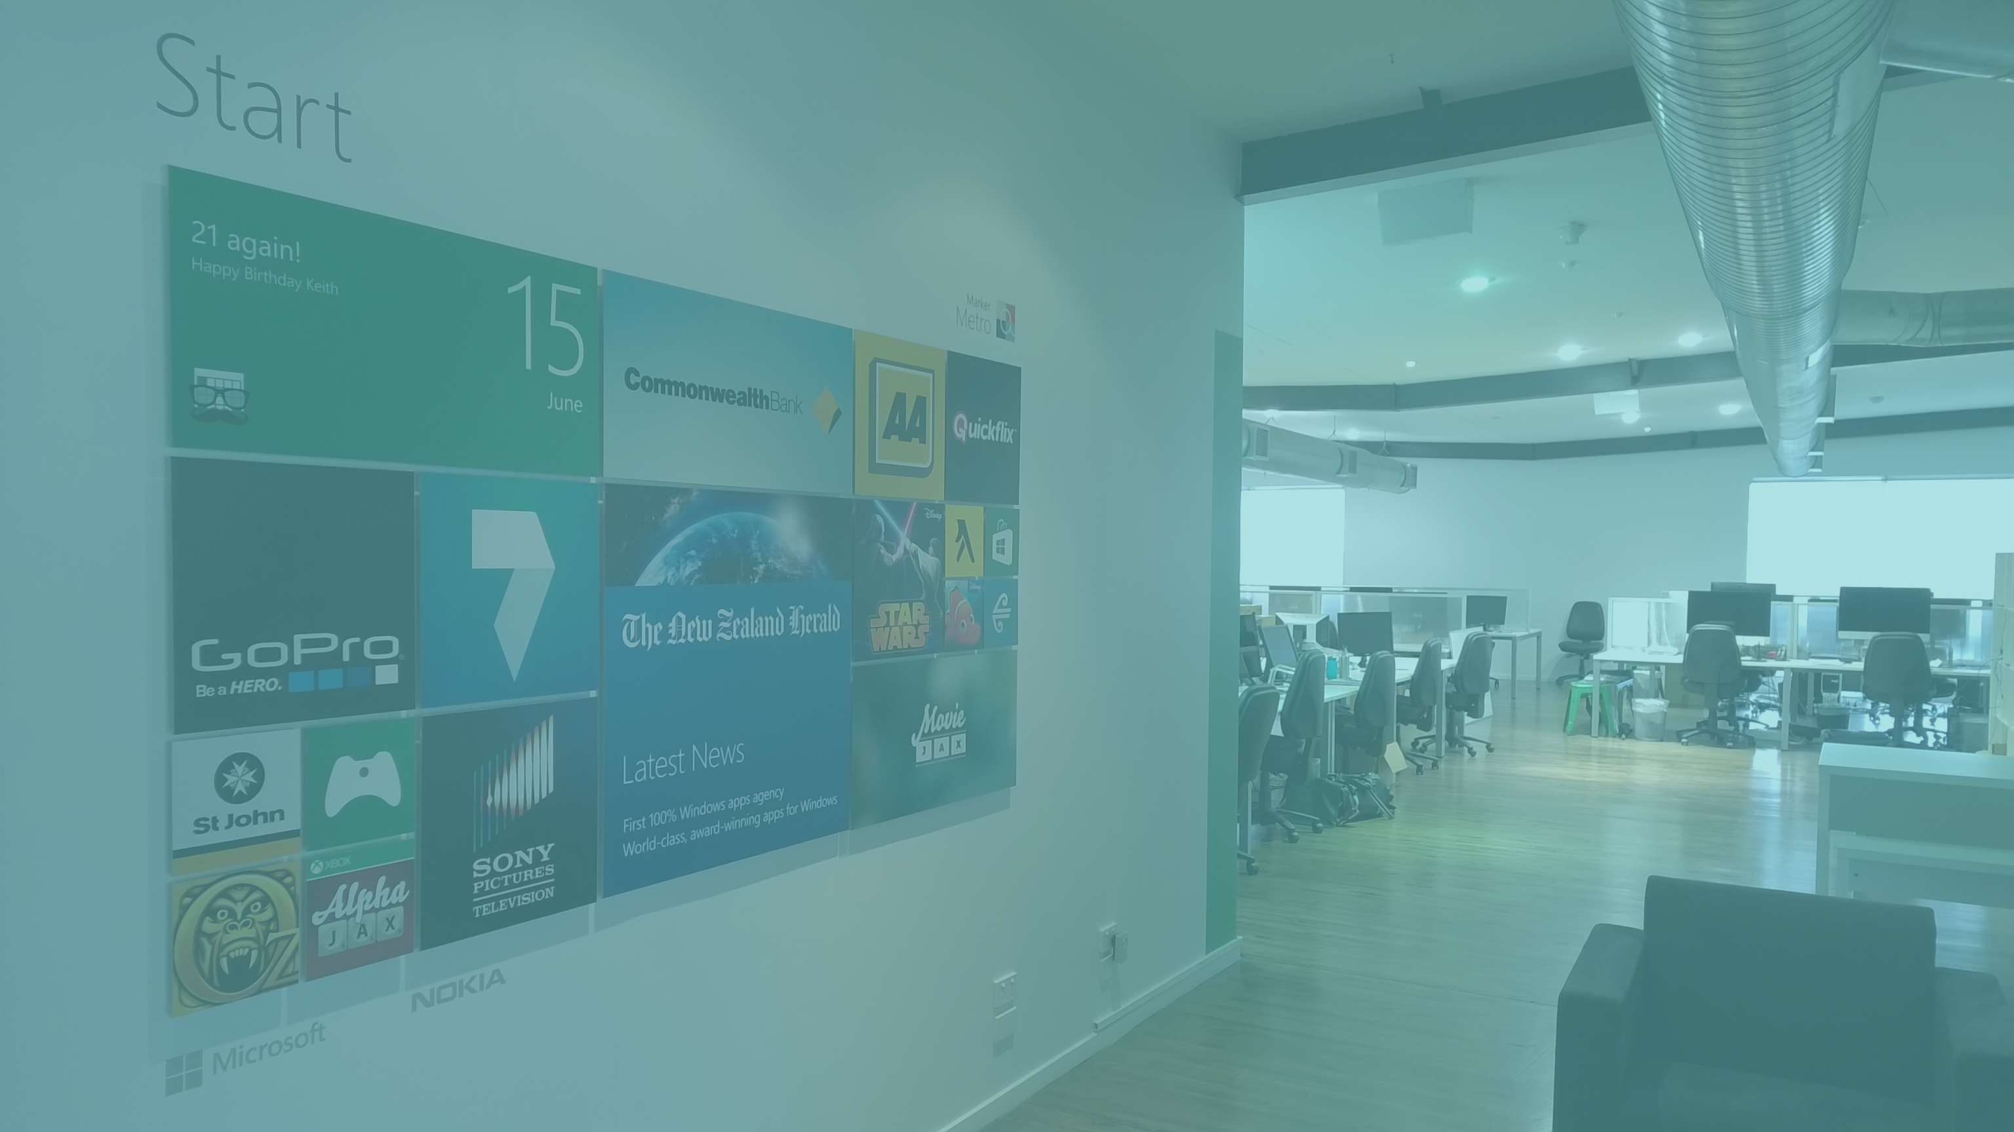




Damian Karzon
Windows App Developer - Marker Metro
NumberTap …and other junk

Slide 4
What is Cordova?
“Apache Cordova is a platform for building native mobile applications using HTML, CSS and JavaScript”
- http://cordova.apache.org/
Notes:
http://phonegap.com/2012/03/19/phonegap-cordova-and-what’s-in-a-name/
Chrome/Webkit analogy

Slide 5
Demo
$>cordova build

Slide 6
Multi-Device Hybrid Apps for Visual Studio 2013

Slide 7
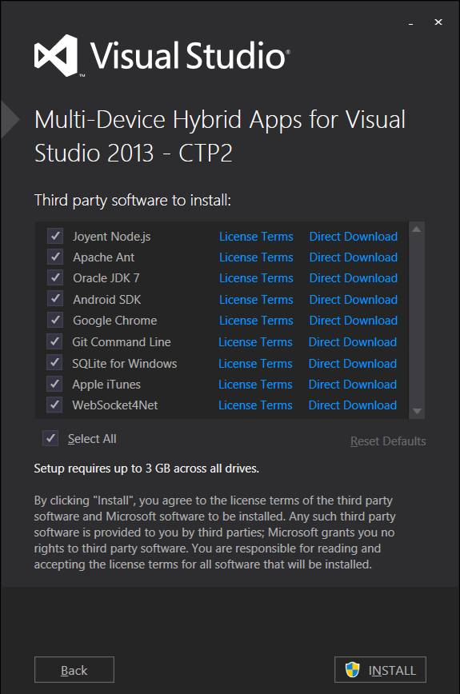
Build/debug for
Windows Store
Windows Phone
iOS
Android
Notes:
http://msdn.microsoft.com/en-us/vstudio/dn722381.aspx

Slide 8
Demo
Multi-Device Hybrid apps

Slide 9

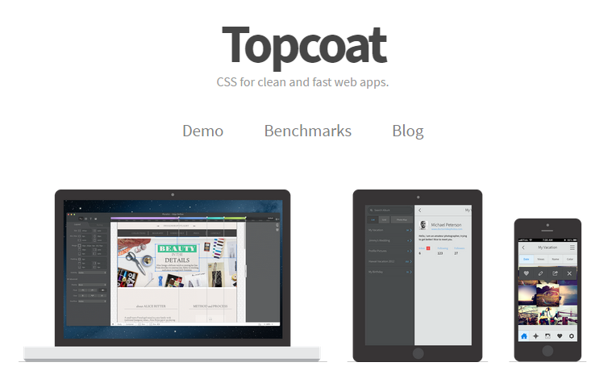
Frameworks/ Libraries
Ionic
ionicframework.com
Topcoat
topcoat.io
KendoUI
telerik.com/kendo-ui
Onsen UI
onsenui.io

Slide 10
What just happened?
What is Cordova?
Tools (Command line and Visual Studio)
Building for multiple platforms
Frameworks/libraries to help

Slide 11
MOAR?!
cordova.apache.org
visualstudio.com/en-US/explore/cordova-vs
github.com/MarkerMetro/MarkerMetro.Talks
@dkarzon

